Slide 1
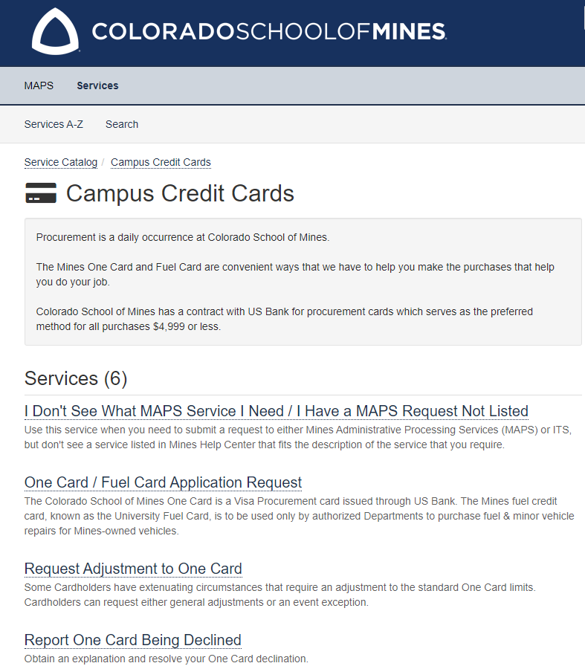
OneCard Expenses
One Card Request & Assistance Remains the Same
Please Visit the MAPS Website for Requesting, Adjustments & Issues with the One Card.
Contact Credit Administrator or Maps Office via Email, Teams or Phone for Any Help or Questions concerning to the One Card.
Only Reconciling Expenses Will Move From Chrome River to WorkDay.
Mary Schwab
Notes:
Carla

Slide 2
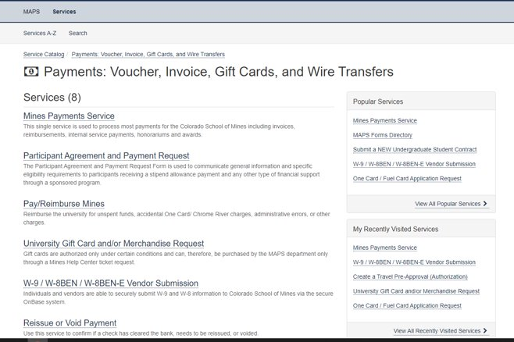
Team Dynamix Expense Requests
(Insert new screenshot)
Mary Schwab
Notes:
Carla

Slide 3
Vendor payment
Steps still need to be taken:
Submission remains in TDX
We still need the W9 for processing payments
Approval in TDX
Check runs are on Tuesdays and Fridays
Super user access – enter vendor payments directly into WD
Mary Schwab
Notes:
Carla

Slide 4
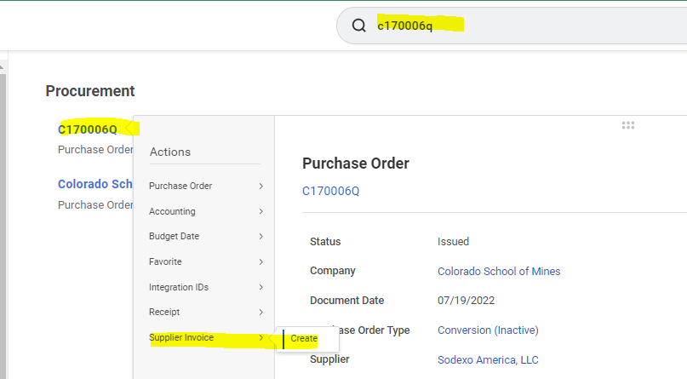
Demonstration
Create supplier Invoices Create invoice off a PO
Mary Schwab

