Slide 1
Workday Training: Foundational Data Model
May 17, 2023
Presenters: Noelle Sanchez, Controller

Slide 2
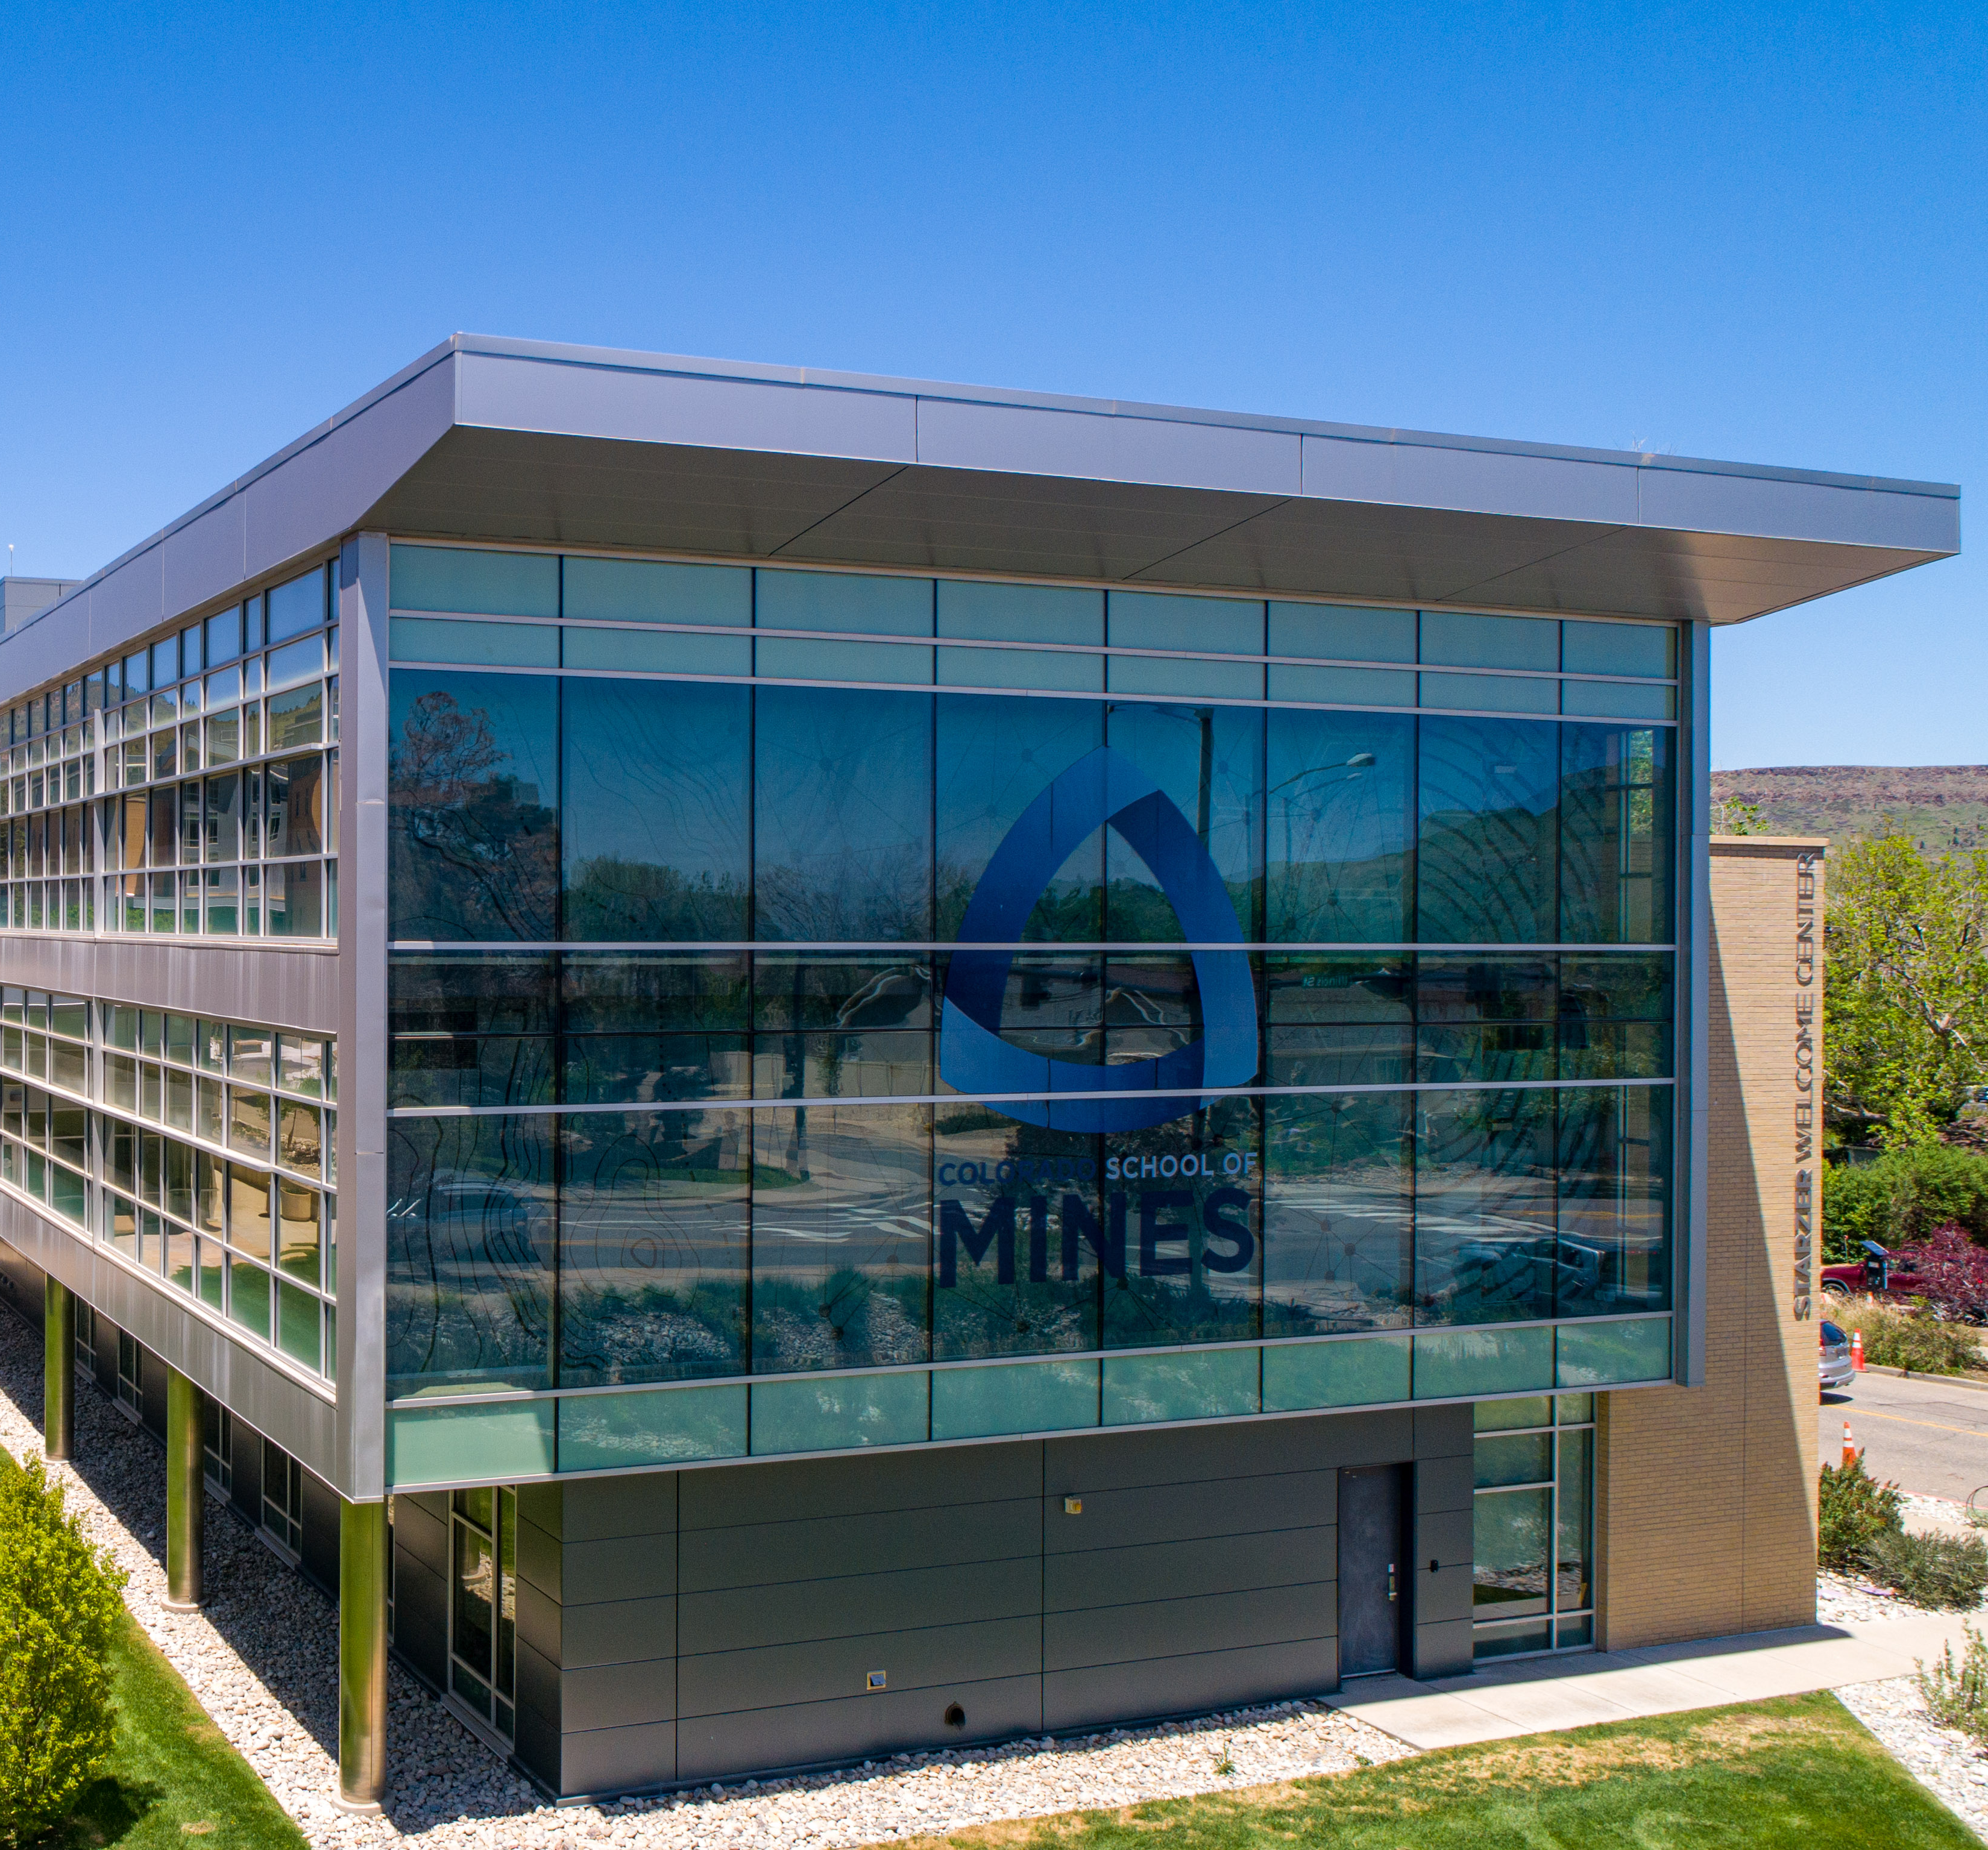
Foundational Data Model
FDM overview
Driver Worktags
Operating & Projects
Ledger Accounts
Spend & Revenue Categories
Function Codes
Notes:
Ian

Slide 3
Foundational Data Model (FDM)
Elements of the FDM in Workday
Driver Worktag
Cost Center
Fund
Revenue/Spend Category & Ledger
Function
Program
Equivalent Element in Banner
Index
Organization
Fund
Account Code
Program
Activity Code
Notes:
Discuss the evaluation process we went through.

Slide 4
Foundational Data Model (FDM)
Notes:
Discuss the evaluation process we went through.

Slide 5
Driver Worktags
3 Main Worktag Types
Operating – Budgeted based only accounts
Does not have balance sheet activity
Will not roll forward each year
No cash funding, only budget
Known as General Fund accounts
Projects – Cash based only accounts
In most cases does not have budget
Foundation Gifts & Capital Projects are the exception
Rolls forward each year
Funded with a cash transfer (in most cases)
Is driven by balance sheet
Grants – Budget based and ORA managed
Budgeted based on sponsor approved budget
Will roll forward each year
May have cash funding
Notes:
Explain why change orders are outside of Workday.

Slide 6
Project Accounts
Operating Accounts
Operating account structure:
Allocated by Budget office
General Funds derived primarily from tuition and fees
Are only for use in the current fiscal year
Primarily for departmental operations
31 Project Types:
Department Rollforward accounts
Professional Development accounts
Research Development accounts
Student fee accounts
Gift accounts
Auxiliary accounts
Student Organization accounts
Athletics
Capital and non-capital Projects
Notes:
Carla

Slide 7
Ledger Accounts
Ledger Accounts are groupings of spend & revenue categories for reporting purposes. Some of the reporting groups these are used for are:
Budgeting
Financial Statements
Data sharing with regulatory agencies
If you are one of the few on campus with access to directly enter Journals, Internal Sales Doc’s (ISD’s), and Invoices:
Invoices will auto generate the Ledger Account for the Spend Account
Journals will require a manual addition of Ledger Account for the Spend or Revenue Account
ISD’s will require a manual addition of Ledger Account for the Spend or Revenue Account
Notes:
Explain why change orders are outside

Slide 8
Spend & Revenue Categories
In Banner - account codes were closely numbered
Revenue 4xxx
Payroll (Salary/Fringe) 51xx & 52xx
Operating expense 53xx
Transfers 8xxx
In Workday
Revenue 4xxx
Salary 5xxx
Fringe 6xxx
Other Operating 7xxx
Transfers 8xxx
Notes:
Explain why change orders are outside

Slide 9
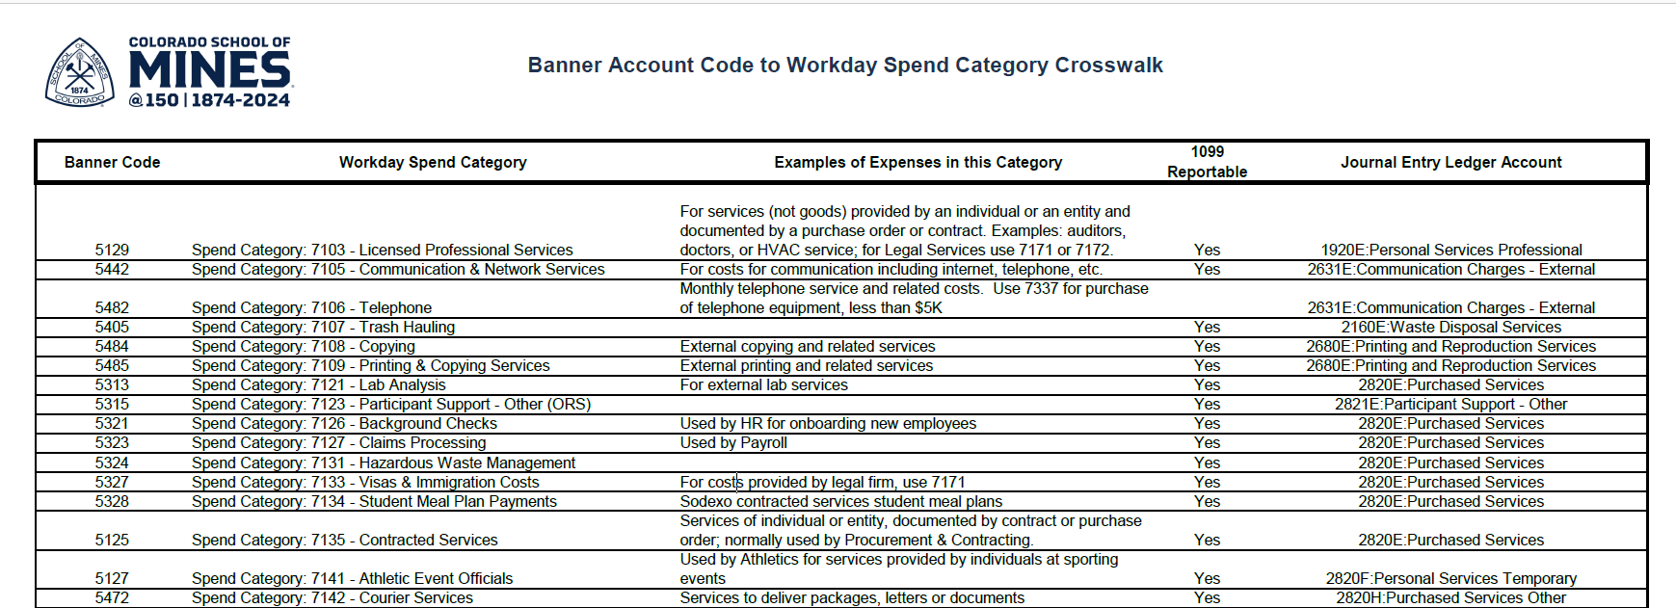
Spend Category Crosswalk
Notes:
Explain why change orders are outside

Slide 10
Function
Is used to define how the resource was used
Function Codes
1100 – Instruction
1200 – Research
1300 – Public Service
1400 – Academic Support
1500 – Student Services
1600 – Institutional Support
1700 – Operations of Plant & Maintenance
1800 – Scholarships & Fellowships
1900 – Auxiliaries Expense
In Banner
These codes were tied to the Index and could not be changed
In Workday
A default is set, but can be changed
Notes:
Explain why change orders are outside

Slide 11
Other Changes
Reduced number of Cost Centers
Historically we created a new cost center per activity
Now each department will only have one (1) Cost Center
Total Cost Centers in WD will be near 300. Total Organizations in Banner are 1,875
Reduced number of Funds
Historically we created a near 1:1 ratio of Index:Fund
Now Funds will truly be limited to type of funding creating a 1:Many
Total Funds in WD are 24. Total Funds in Banner is 10,081
Notes:
Explain why change orders are outside

Slide 12
Going Forward
New Worktag requests
Will be approved and created upon request
Will be the responsibility of the financial manager
Type will be determined by the Budget, General Accounting, or Office of Research
New Fund Requests
Will not be approved unless supported by a major change in financial statement reporting at the University level
New Cost Center Request
Will only be approved when substantiated by a new department, center or unit
Notes:
Explain why change orders are outside

Slide 13
Questions?

Slide 14
THANK YOU!

