Slide 1
Workday Training: Expenses
May 17, 2023
Presenters: Mary Schwab, Amalia Queller

Slide 2
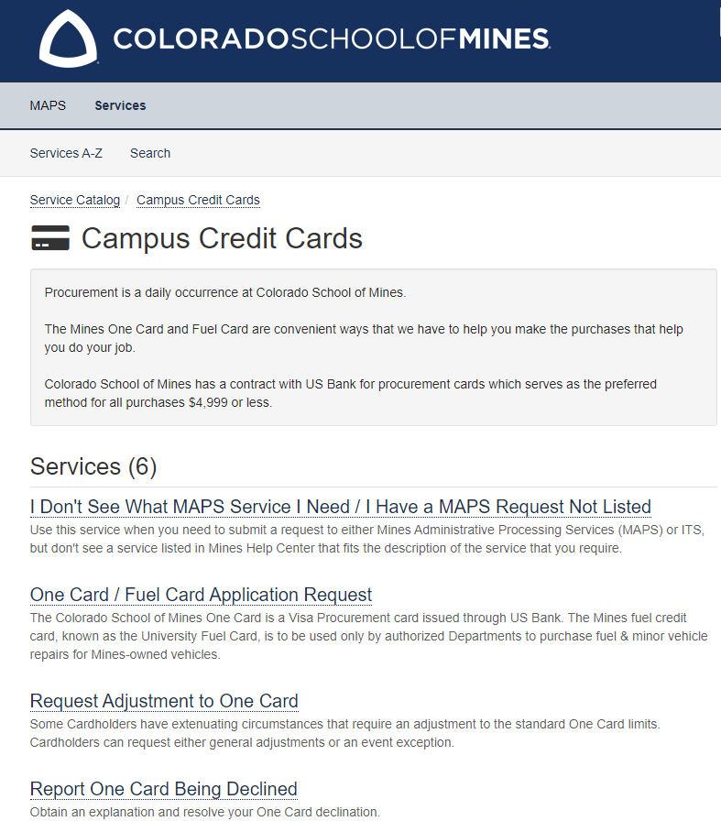
OneCard Expenses
One Card Request & Assistance Remains the Same
Please Visit the MAPS Website for Requesting, Adjustments & Issues with the One Card.
Contact Credit Administrator or Maps Office via Email, Teams or Phone for Any Help or Questions concerning to the One Card.
Only Reconciling Expenses Will Move From Chrome River to WorkDay.
Notes:
Carla

Slide 3
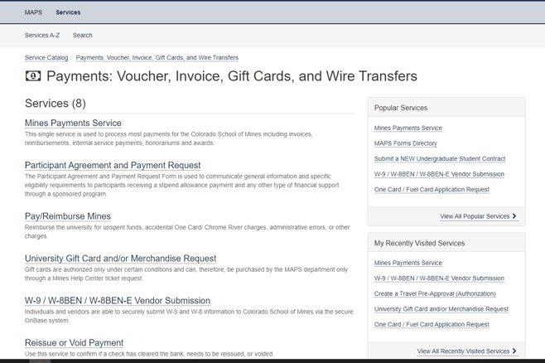
Team Dynamix Expense Requests
(Insert new screenshot)
Notes:
Carla

Slide 4
Vendor payment
Steps still need to be taken:
Submission remains in TDX
We still need the W9 for processing payments
Approval in TDX
Check runs are on Tuesdays and Fridays
Super user access – enter vendor payments directly into WD
Notes:
Carla

Slide 5
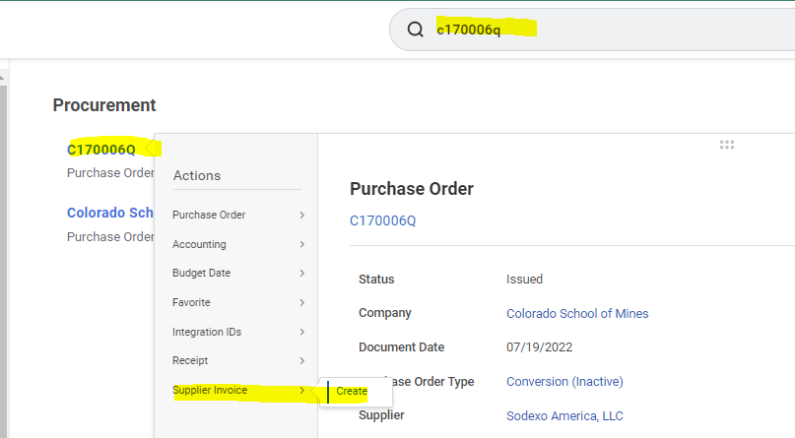
Demonstration
Create supplier Invoices Create invoice off a PO

Slide 6
Workday Expense Module
Find Expense Reports & Spend Authorizations
Create Expense Report (Travel & Non-Travel)
Create Spend Authorization & Request Cash Advance
(Pre-Approval/TA)
Strategy

Slide 7
Create Spend Authorization
Spend Authorizations are the new Pre-Approvals/TAs
Detailed Business Purpose (Answering the who/what/where/when/why)
Request a Cash Advance
Submit or Save for Later

Slide 8
CREATE SPEND AUTHORIZATION (Pre-Approval/ TA) Header Information
Click on the Search bar, Create Spend Authorization, and select the task.
Company will auto-populate
Enter the Start and End Date of the Trip/Travel.

Slide 9
CREATE SPEND AUTHORIZATION (Pre-Approval/ TA) Header Information Continued
4. DESCRIPTION is the Spend Authorization Report Name. Use Naming Convention below:
DEPT Initials_General Description (CO_Attend XYZ Conference)
5. BUSINESS PURPOSE (the new REPORT TYPE) select from the drop down.
6. PAYMENT TYPE: this will default but if you need to override this you can.
7. JUSTIFICATION: a Detailed Purpose/Description of the trip. (ensure you include travel
destination: City, Country OR City, State.)
• Make sure you are answering the Who, What, When, Where & Why. Instead of “Attend Conference” use “Attending XYZ Conference to Present Research related to Grant XXXXXX”

Slide 10
CREATE SPEND AUTHORIZATION (Pre-Approval/ TA) Spend Authorization Lines
8. Click Add to enter an individual authorization line to the report.
9. Select the Expense Item. For Per Diem & Airfare you will be prompted to add the destination on the right-hand side.
10. Enter the Total Estimated Amount.
11. Budget Date will default; this does not need to be changed.
12. Enter a Memo, this is required and should be brief description of the Expense. As a reminder these are estimated expenses, and no receipt are required.
You can use the Quantity and Per Unit Amounts to calculate the estimated budget.

Slide 11
CREATE SPEND AUTHORIZATION (Pre-Approval/ TA) Spend Authorization Lines: Adding a Cash Advance
13. Unlike in Chrome River Cash Advances will be requested for the applicable expense item as opposed to a bulk amount for the trip. You will have the option to Check the Cash Advance Requested box, on each line item. Remember to only indicate this on allowable line items like per diem, mileage and ground transportation at your travel destination.
Cash Advances are paid 7-10 business days before travel begins and can only be requested for expenses that will be paid out-of-pocket while physically traveling. Cash Advances should not exceed $1,500.00 per person.

Slide 12
CREATE SPEND AUTHORIZATION (Pre-Approval/ TA) Spend Authorization Lines continued
14. Enter Driver Worktag (Grant, Project or Operating Account) and Additional Worktags automatically populate. Please note that as you add each additional line item the Driver Worktag will auto populate.
If you need to charge more than one worktag (index) you will need to make an individual line item for each expense and worktag.
Note, you cannot charge more than one worktag on the report if you request a cash advance.

Slide 13
CREATE SPEND AUTHORIZATION (Pre-Approval/ TA) Spend Authorization Lines continued
16. Select the Attachments Tab. Use the drag & drop functionality or click Select Files to choose a file from your computer. Attachments will only be required for Student International Travel- for these students MUST include proof of their CISI Insurance and Travel Registration from the Office of Global Education.
17. Once all expenses are added you can either Submit or Save for Later. If you Submit the report, it will start routing for approval based on the business process built into Workday. If you Save the report for later, you will be able to come back & update it. Saving is the same as a draft report in Chrome River.
15. Continue to add line items for each estimated expense. Once you have added all your expenses you can check the overview -summary above the header information.

Slide 14
Create Expense Report
Detailed Business Purpose (Answering the who/what/where/when/why)
Selecting One Card Expenses
Adding Reimbursable Expenses
Submission, Save for Later, Change, Close
Tracking Approvals

Slide 15
CREATE EXPENSE REPORT
1. Click on the Search bar, enter Create Expense Report, and select the task.
2. Select one of the following options:
• Create New Expense Report
• Copy Previous Expense Report
• Create New Expense Report from Spend Authorization.

Slide 16
CREATE EXPENSE REPORT Detailed Business Purpose (Answering the who/what/where/when/why)
Will always stay the same
Note: if connected to Spend Authorizations Business Purpose will auto populate
3. MEMO FIELD
Expense Report Name with Naming Convention
DEPT Initials_General Description (CO_Attend XYZ Conference)
Detailed Purpose/Description; for Travel include dates and destination.
Make sure you are answering the Who, What, When, Where & Why. Instead of “Attend Conference” use “Attending XYZ Conference to Present Research related to Grant XXXXXX”
4. BUSINESS PURPOSE (the new REPORT TYPE) select from the drop down.

Slide 17
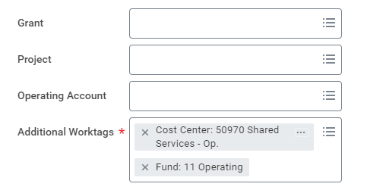
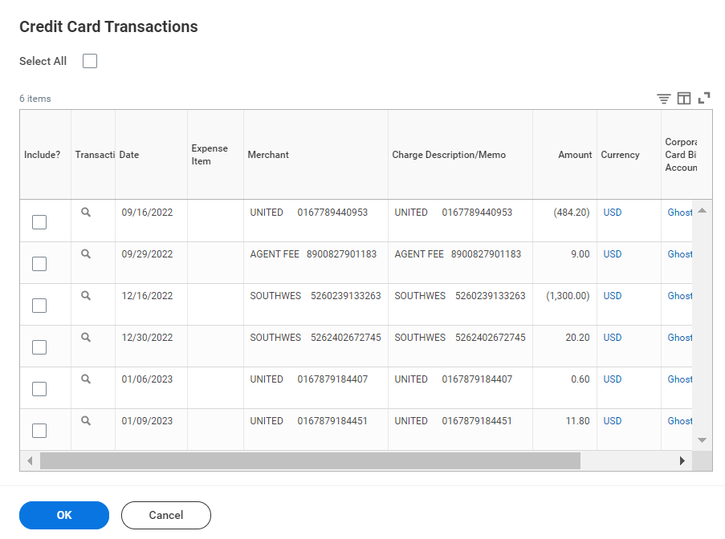
CREATE EXPENSE REPORT Driver Worktag (Allocation Index) & One Card Charges
5. Select a Driver Worktag, you will be able to adjust this on each line item once you get to the next part of the report. You can only select a Grant, Project OR Operating Account.
6. If you have One Card charges you will see them listed at the bottom of this screen. You can select applicable expenses and they will be added to your report. You can also add them individually in the “Expense Lines” section. Once you have picked the charges you want and or do not have charges click “OK”.

Slide 18
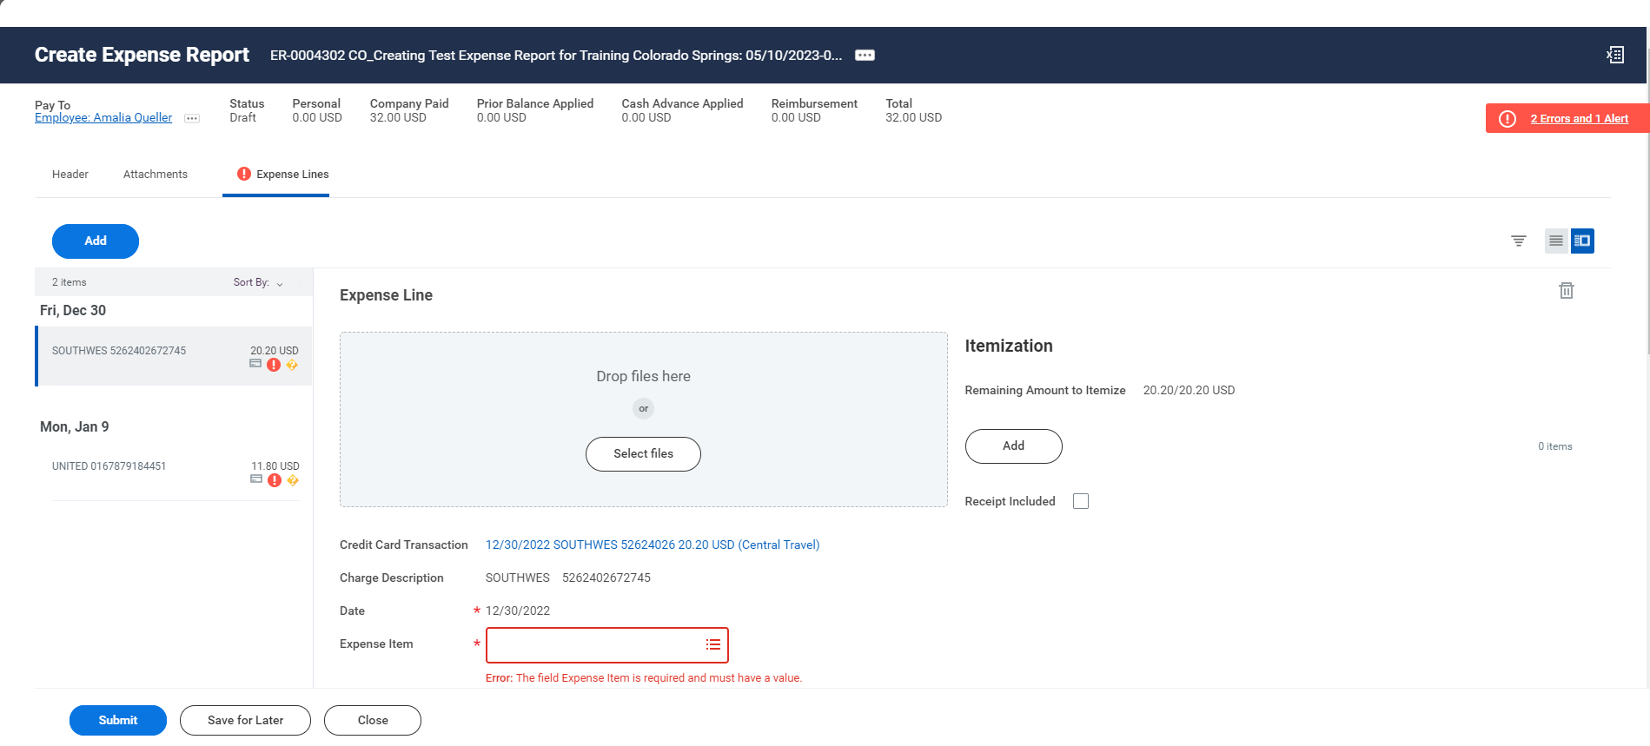
Anatomy of the EXPENSE LINES SECTION
Report Title will be Report # and beginning of memo Section
Summary Bar: Shows the payee, report status, amount prepaid (One Card), previous balances applied, reimbursements amount, and report total.
Click to add additional line items.
Click “Add” under itemization to split the expense amongst multiple driver worktags.
Summary of all expense line items on the report.
Drag and Drop receipts or click “Select Files” to upload.

Slide 19
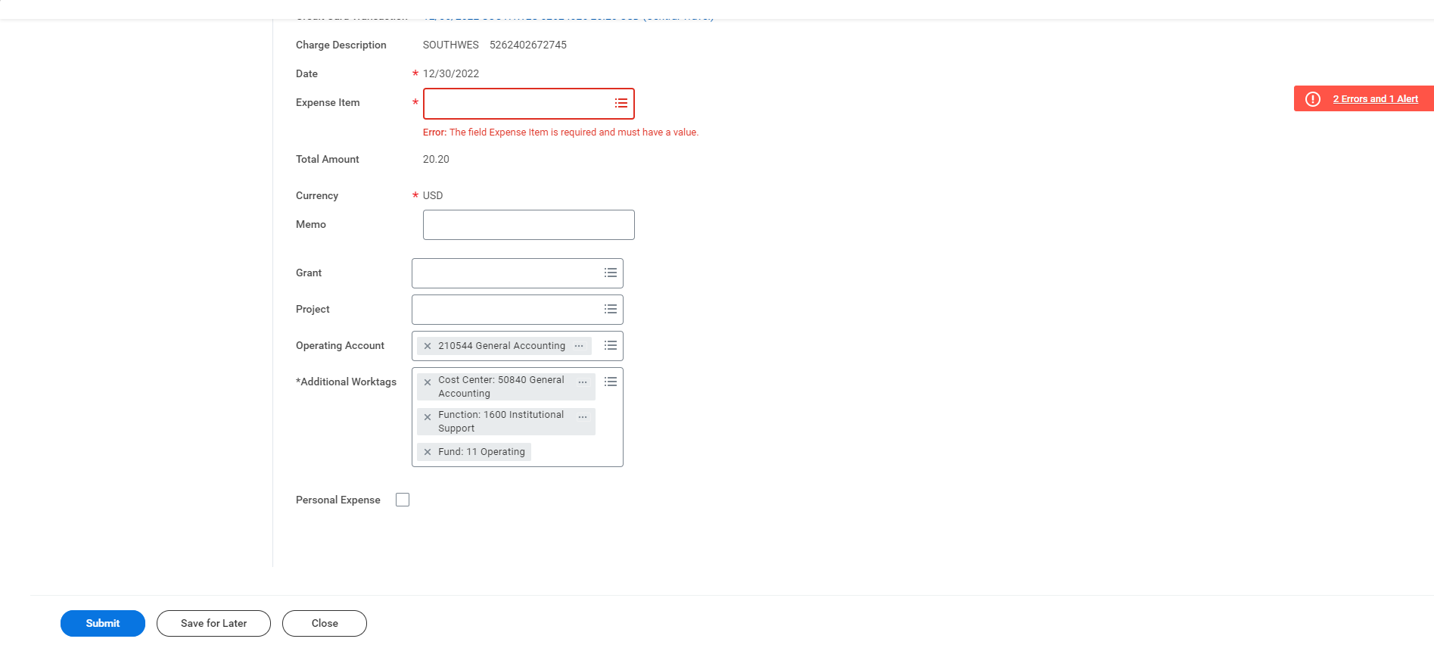
Anatomy of the EXPENSE LINES SECTION ctn.
Charge Description & Date will auto-populate if this is a One Card charge. If reimbursable expense- no Charge Description but you will need to add the date and ensure it matches the actual purchase date for the transaction.
EXPENSE ITEM: Either select from the drop down or search the key word. This is the account code ie: Mileage, Airfare etc.
Memo, like on the header page should answer the Who, What, When, Where & Why to explain how this is an allowable Mines Business Expense.
Personal Expense: Only used for an accidental personal expense that needs to be repaid. If only a portion of the charge is personal, use itemization.
The Worktag selected on the header page will default in, you can change this, or this will be blank if you add “Itemization” which allows you to split the expense between multiple worktags.
The “Additional Worktags” will auto-populate based on the driver Worktag being used.

Slide 20
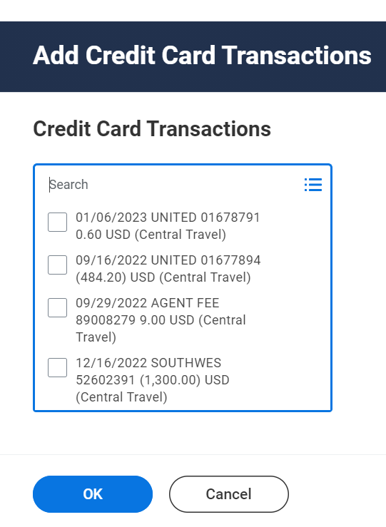
CREATE EXPENSE REPORT Adding a Line Items (One Card Charge)
7. Click Add, then choose “Credit Card Transaction” to add one of your One Card Charges that need to be reconciled.
8. Once you select “Credit Card Transaction” you will be taken to a new screen (see screenshot on the right) where you can select one or more One Card charges to add to your report. Once you have picked the items you need, click “OK” and you will be brought back to the EXPENSE LINES section of your report.

Slide 21
CREATE EXPENSE REPORT Completing Line Items for selected One Card Charges
Receipts are required for ALL One Card charges (unless it is a credit)
9. If you selected One Card charges on the header page of added them (see previous slide), it is normal to see the warnings and missing information. You will need to add the details for each charge selected.
Add receipt & select the correct Expense item from the drop down or by searching for the key word
Memo: add detailed description for the business purpose of the expense, you may see additional required details for certain expense items on the right side of the screen.
Verify the driver worktag, update if necessary or add itemization to split between multiple worktags

Slide 22
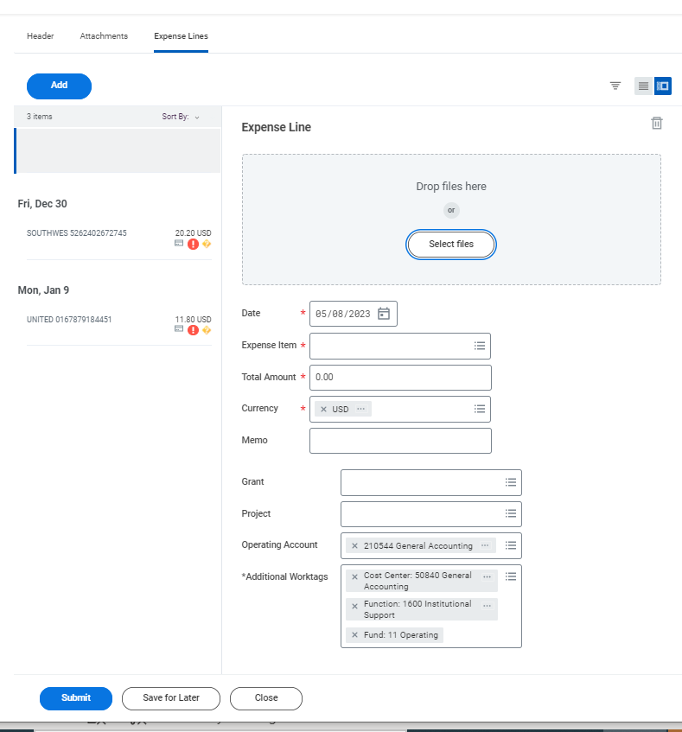
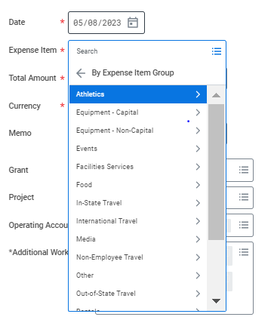
CREATE EXPENSE REPORT Adding a Line Items (Reimbursable Expenses)
11. After adjusting the date you must select the appropriate Expense Item. More instructions for itemization and expense items will follow.
10. Click Add, & this time “New Expense” to add a reimbursable expense. A new line item will show at the top of the list on the left-hand side, it is highlighted, and no details will display until you add transaction information. Using the Calendar icon, select the Date when the expense incurred/paid.

Slide 23
CREATE EXPENSE REPORT Adding a Line Items (Reimbursable Expenses) Continued
12. Enter the Total Amount for this expense line. Additional instructions for adjusting the currency will follow.
13. Using the drag and drop functionality add any relevant supporting documents in the Attachments box or click Select Files to choose a file from your computer. Receipts are required for all reimbursable expenses totaling $50.00 or more.
14. Memos will be required for all line items. For the Memo add a detailed business purpose of the expense which answers the Who, What, When, Where & Why. Additional required details for certain expense items may appear on the right side of the screen.
15. You can adjust the Driver Worktag, or it will default to the last one used. Also, if you need to split the expense amongst more than one Driver Worktag (index) see the instructions on itemization to follow.

Slide 24
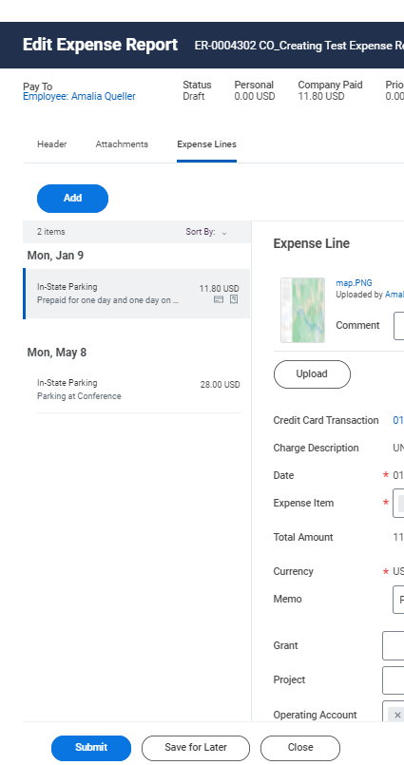
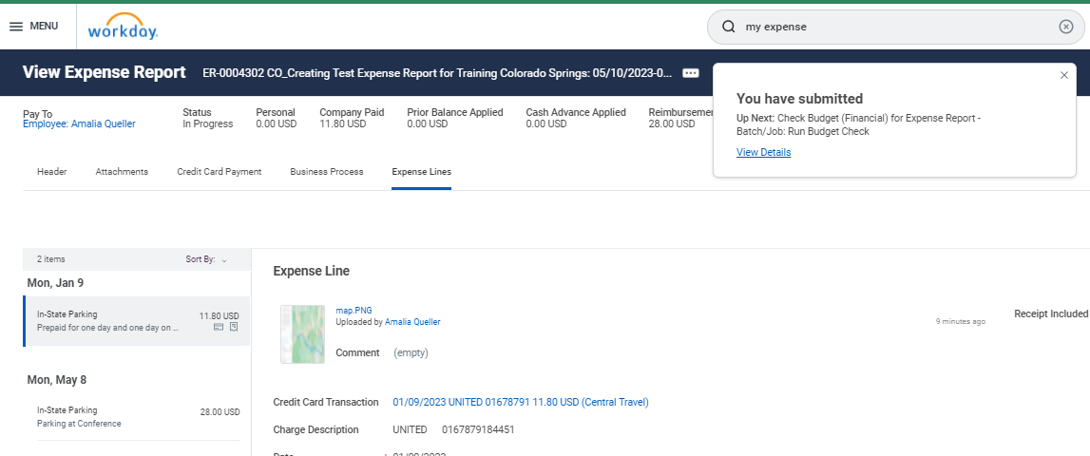
CREATE EXPENSE REPORT Submitting your Expense Report
16. To save or update this line item you can click on any of the line items shown in the list on the left-hand side or go to the “Add” button to include another line-item; follow steps 10-15 for reimbursable items & steps 7-9 to add One Card charges.
17. Once you have added all you expenses you can either Submit or Save for Later. If you Submit the report, it will automatically start routing for approval based on the business process built into Workday. If you Save the report for later, you will be able to come back and update it. Saving is the same as a draft report in Chrome River.
Notes:
Connecting SA
Itemization
Personal Expense
Currency Conversion
Custom Validations
Tracking approvals
My Spend Auth
My Expense Reports

Slide 25
Questions?

