Slide 1
Workday Training: Procurement and Contracting
June 2023
Presenters: Danielle Davis and Team

Slide 2
Before we chat about Workday
Send all FY23 requests by June 12th. All goods and services need to be received by June 30.
You can send in your FY24 requests (either new or change orders). We will process in Workday as soon as possible.
Need a refresher on procurement and contracting rules? Contact procurement@mines.edu, your dedicated Purchasing Agent will set a meeting.
Public Service Announcement: don’t sign contracts, send them to procurement@mines.edu.
Check out the new Procurement and Contracting website https://www.mines.edu/procurement/
Notes:
Ian

Slide 3
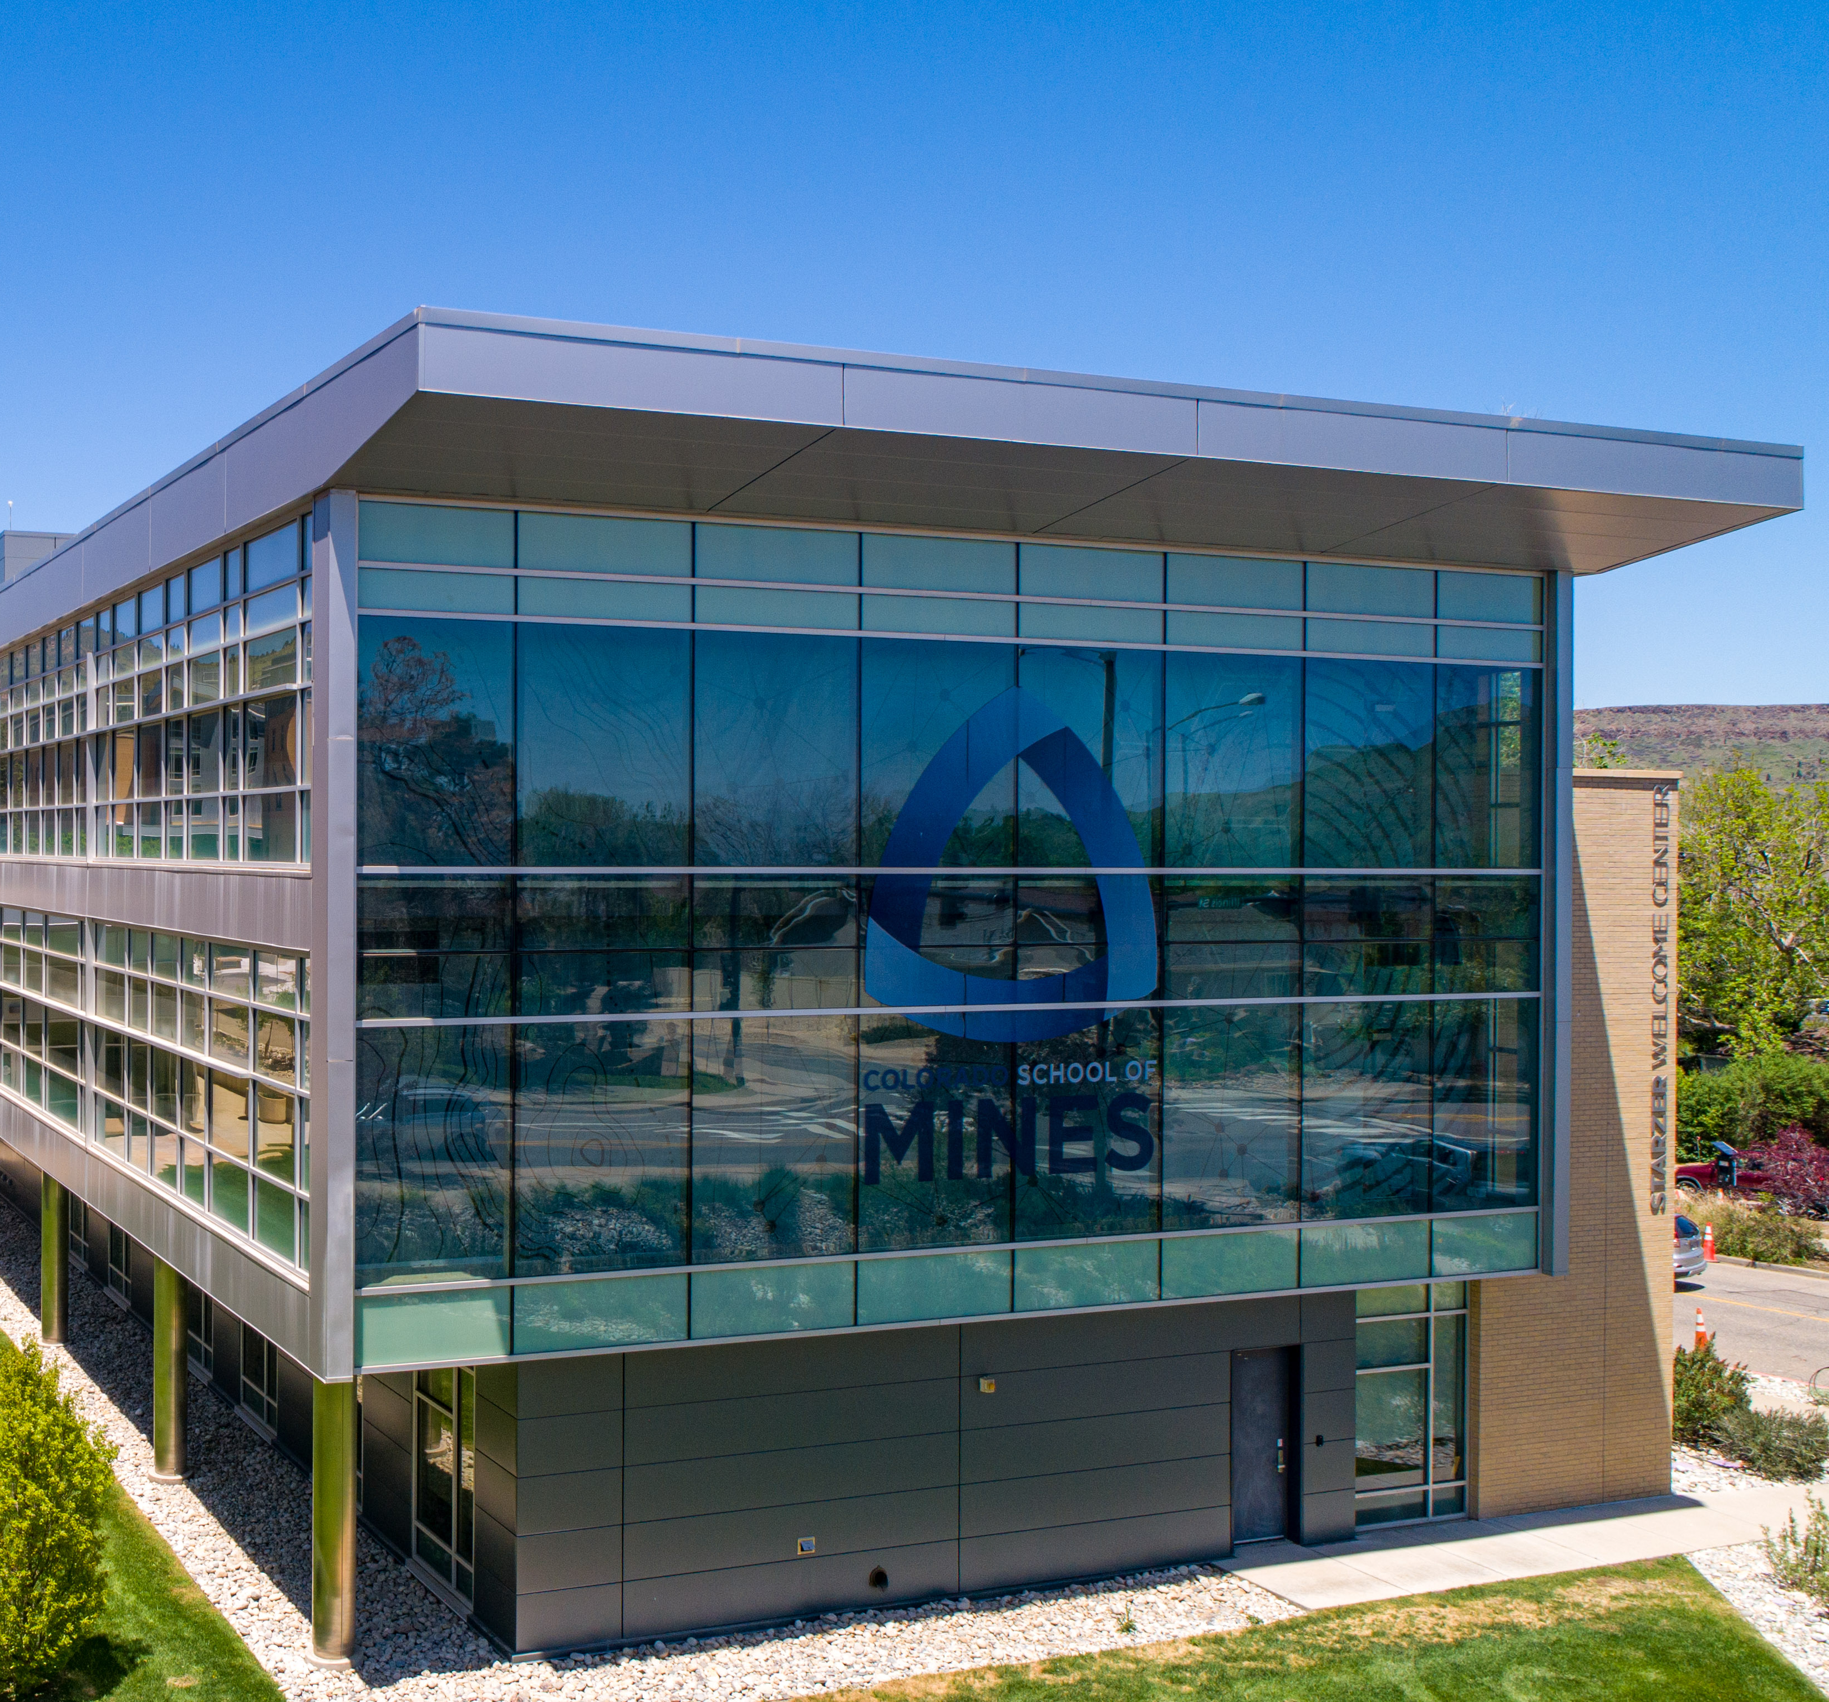
Topics:
Current state, changes
Conversion POs
Requisitions
Fund Manager Approval
Purchase Orders
Change Orders
Reports and finding info
Notes:
Ian

Slide 4
Current state / changes
Send purchase and contract requests to procurement@mines.edu.
Procurement will enter requisitions into Workday (WD).
Approvals – some approvals are a workflow in WD.
Fund Manager, Logo Approval, Capital Asset.
Procurement will issue the Purchase Order (PO).
Day live forward, all documentation related to a purchase will be in WD, not OnBase.
Notes:
Ian

Slide 5
Conversion of existing Purchase Orders (PO)
POs being converted from Banner to Workday
Any non-1001 POs that have a balance that cannot be closed or that are needed for FY24 (i.e., ORA subawards, construction, one-time purchases that haven’t been received).
Ongoing contract POs that are needed in FY24.
Contract POs with no balance but the contract continues into FY24, only the last line with $0.
Contract POs (non-1001) with balances that are needed in FY24.
All POs that use 1001 will either be closed or zeroed out.
Information being converted from Banner to WD
Line Descriptions, balances only (non-1001).
Funding source.

Slide 6
Conversion of existing Purchase Orders
The PO numbers will be the same as they are in Banner.
How do we see all data related to converted PO?
A mix of Banner, OnBase, and Workday.
If you are having trouble with seeing what you need, email procurement@mines.edu
Conversion POs will not be in WD until July 20th-ish.
For Documentation related to a PO, including invoices.
Prior to July 1 - Banner and OnBase will have all history.
After July 1 – new documentation will be in WD.

Slide 7
Between now and June 30
The Procurement Team will be reaching out on open purchase orders.
Goal is to close any POs that are not needed in FY24 and do not need to be converted to WD.
Make sure campus users are aware of any POs that need to be invoiced (because goods or services have been received but we haven’t received the invoice).

Slide 8
Requisitions
Send purchase and contract requests to procurement@mines.edu
Include quote(s), funding worktag (index), spend category (account code).
Requisitions have workflows built in WD
Approvals in WD
Capital asset
Logo
ORA
Fund Manager (last approval). If there are multiple funding sources, each fund manager approves the requisition.
Spend Categories (aka Account Codes) have been trimmed down and consolidated.

Slide 9
Fund Manager Approval
Fund Manager Approvals in WD
Each Fund Manager will have to approve requisitions in WD.
Delegation
There is a delegation function in WD that is to be used when someone is OOO. More to come on this later.

Slide 10
Requisition to Purchase Order
Once Req is fully approved by all necessary approvers, it routes back to Procurement to issue the PO.
Purchase Orders – will be sent out as they are today, from procurement@mines.edu, copying all end users and vendor.
For new POs related to contracts, can only assign a WD PO however we will still include the contract number (example: C230694) in the Memo Field. Will be able to search by the C number using RPT531 – Contract Purchase Orders.

Slide 11
Change Orders in WD
Requesting a Change Order.
Send request via email to procurement@mines.edu.
Fund Manager and other approvals will be outside of WD, because of limitations in WD approval routing.
Note: For conversion POs that need FY24 change orders
Will not be able to process until third-ish week in July.
Send in requests, we will hold the change order requests until July 20th-ish.

Slide 12
Reports / finding things
Verbiage:
Screens (Banner) = Reports (Workday)
Vendors (Banner) = Suppliers (Workday)
Access – all employees will be able to see all POs and the data on that PO.
How to see if Suppliers are in WD.
Review what is on a PO in WD.
How to look at invoices against a PO or a Supplier.
Notes:
kathleen

Slide 13
Your Procurement and Contracting Team
Purchasing Team: Contracts Team:
Melissa Dichard, Purchasing Agent Sheri Atencio-Church, Contract Administrator
Jennifer Good, Purchasing Agent Steve Hein, Contract Administrator
Tyler Guerra, Purchasing Agent Amir Nahavandi, Contract Administrator
Joann Heimerman, Purchasing Agent Jenna Sowers, Contract Administrator
Theryn Ridge, Senior Purchasing Agent
Reach the team at procurement@mines.edu
Danielle Davis, Interim Director, ddavis@mines.edu
Website: https://www.mines.edu/procurement/
Notes:
kathleen

Slide 14
Questions?

Slide 15
THANK YOU!

