Slide 1
Workday Training: Grants
June 7th, 8th, and 15th
Presenters: Corey O’Connor & Johanna Eagan

Slide 2
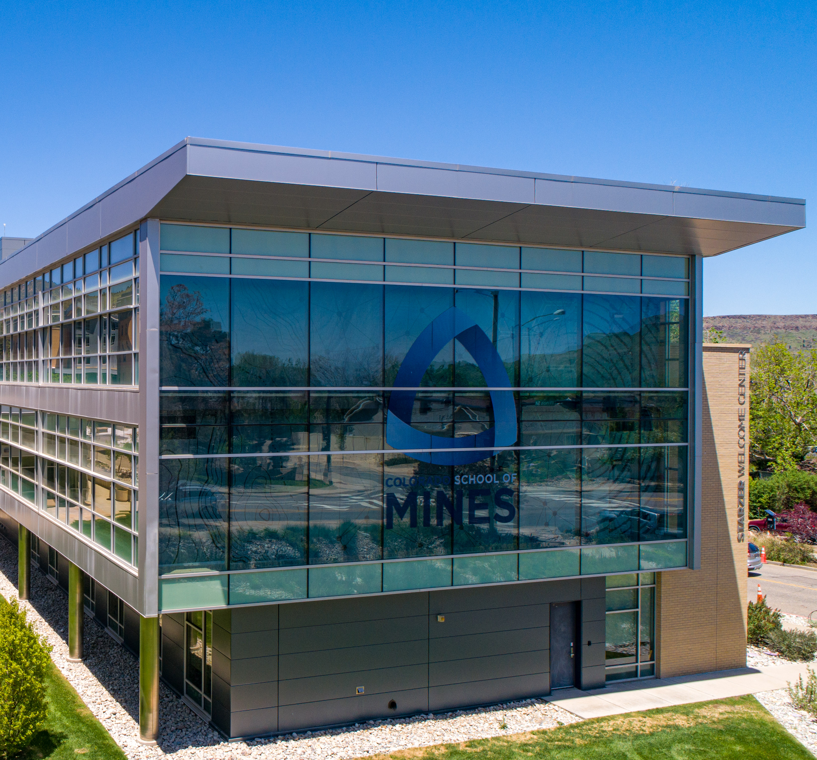
Grants
New Terminology
Award Information
Reporting
Time and Effort Certifications
Next Steps in WD Transition
Notes:
Ian

Slide 3
Grants: New Terminology!
Banner Term | WD Term
Grant | Award
Fund | Grant
Index | Grant Driver Worktag
Account Code (expense & revenue) | Spend Category & Revenue Category
Account Code (budget) | Ledger Categories
Cost Basis | Object Class Set
IDC Return | F&A Revenue Allocation Profile
IDC Rate | F&A Rate Agreement
Start & End Dates | Award Schedules (Contract Start Date & Contract End Date
Grant Title | Name
Notes:
Ian

Slide 4
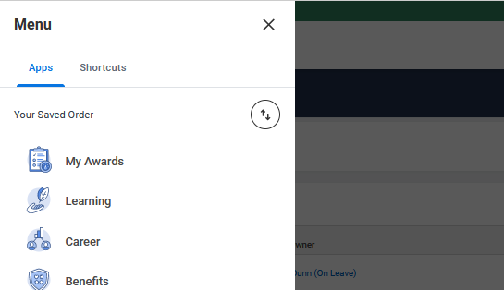
Grants: Award Information
Individuals can navigate to Awards in two ways:
1. Using the Menu bar on the left
2. Using the report “Find Awards”

Slide 5
Grants: Award Information

Slide 6
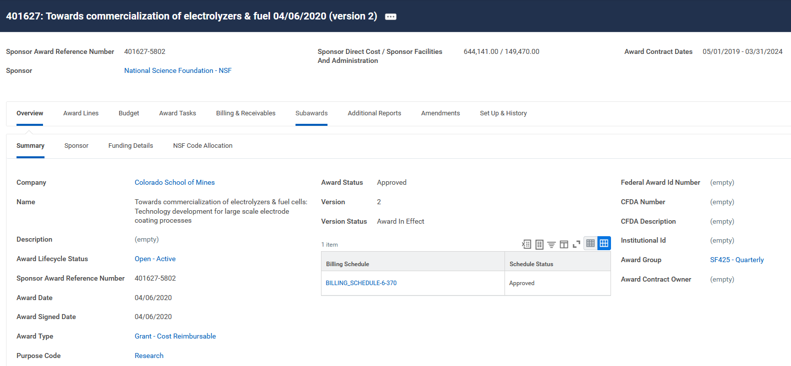
Grants: Award Information
Notes:
kathleen

Slide 7
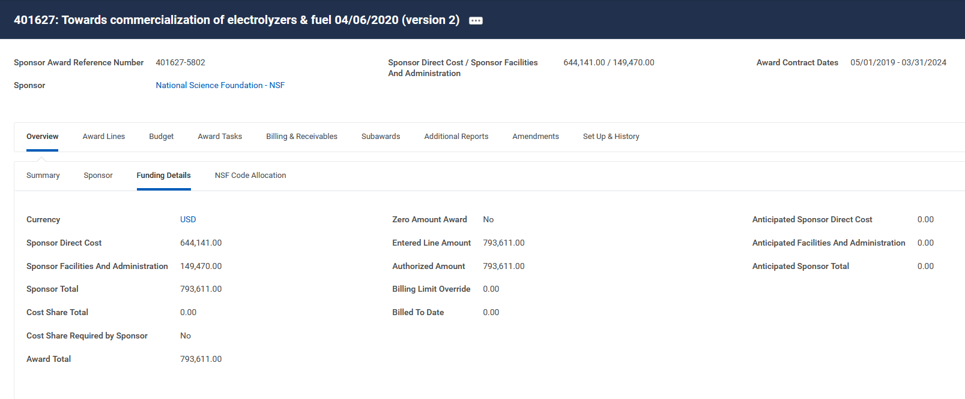
Grants: Award Information
Notes:
kathleen

Slide 8
Grants: Award Information

Slide 9
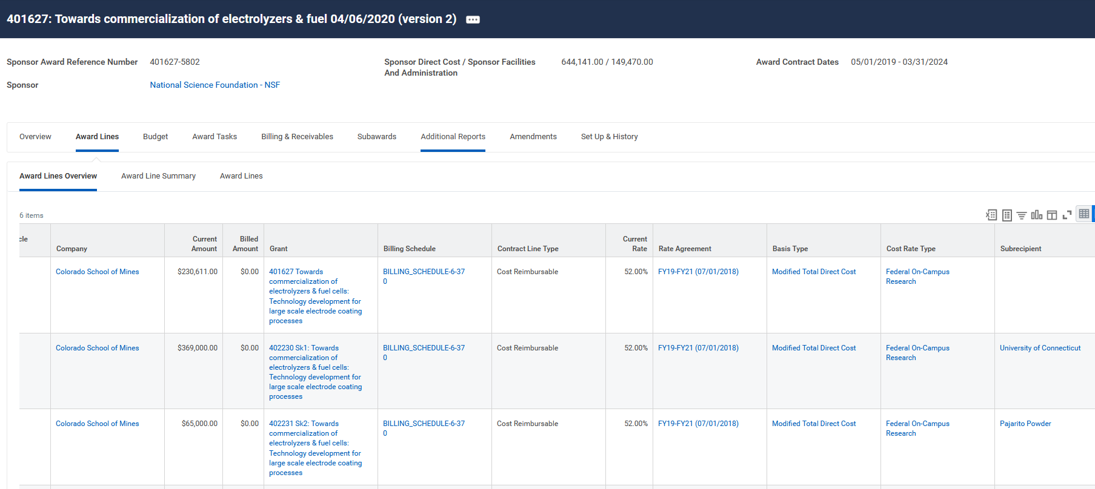
Grants: Award Information
Notes:
kathleen

Slide 10
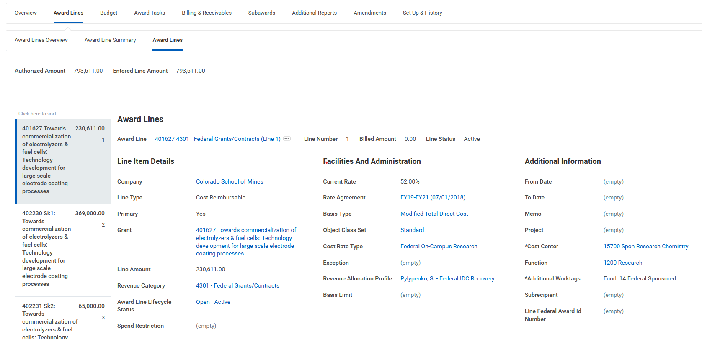
Grants: Award Information
Notes:
kathleen

Slide 11
Grants: Award Information

Slide 12
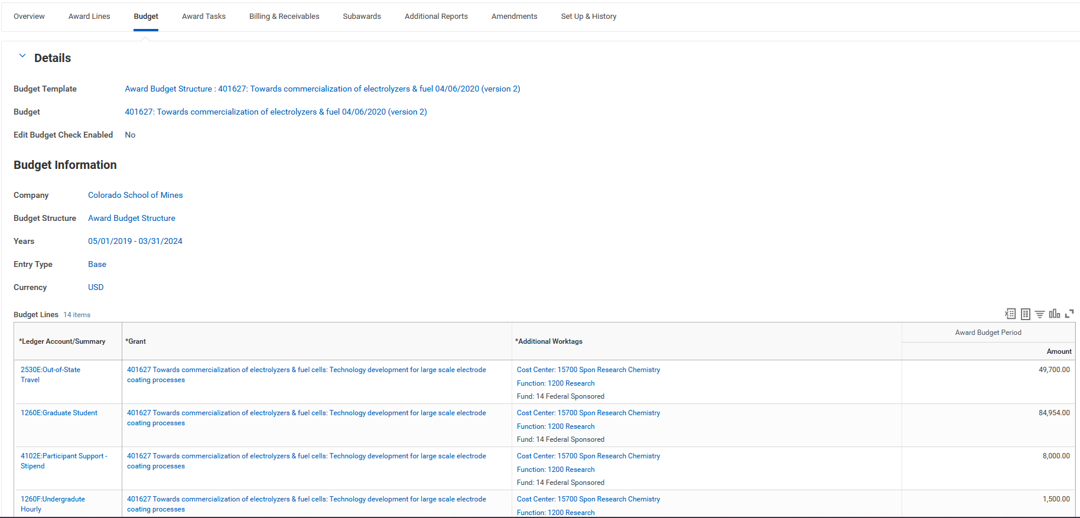
Grants: Award Information
Notes:
kathleen

Slide 13
Grants: Award Information
Notes:
kathleen

Slide 14
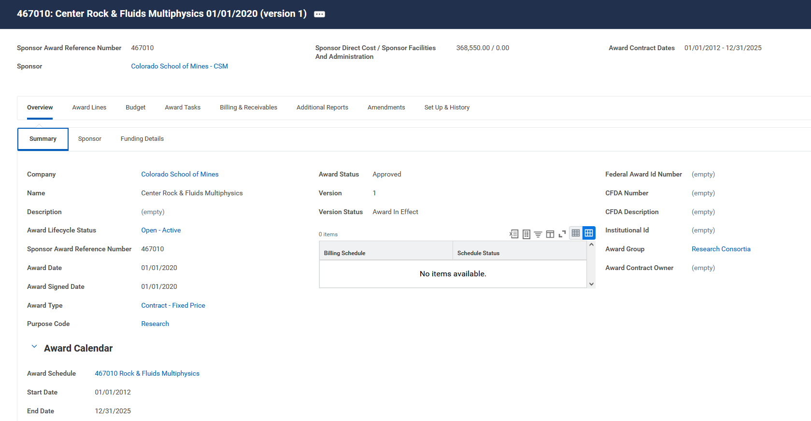
Grants: Award Information – Consortia!

Slide 15
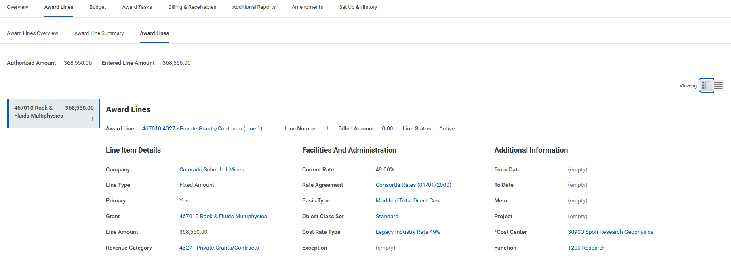
Grants: Award Information – Consortia!

Slide 16
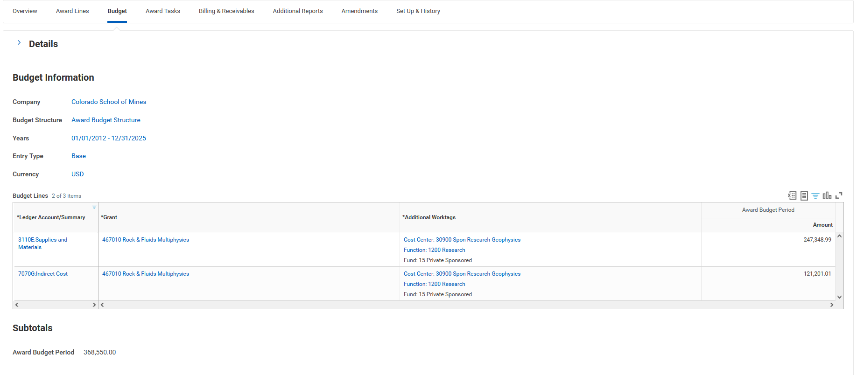
Grants: Award Information – Consortia!

Slide 17
Grants: Reporting
Notes:
kathleen

Slide 18
Grants: Reporting

Slide 19
Grants: Reporting

Slide 20
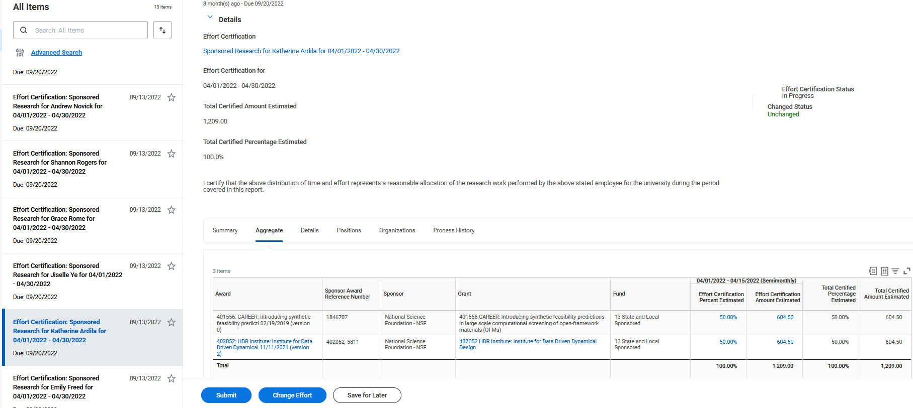
Grants: Time & Effort Certifications

Slide 21
Recap - What’s Changing for Grants?
Task | Today | Workday
Terminology | Banner Terms
Award Information | Banner screens not open to many on campus | WD screens will be open to campus in a read-only
Reporting | AFBR & COGNOS (one day delay) | WD reports (real time!)
Time and Efforts | OnBase & Email | Future corrections in real time right in WD. Elimination of side processes.
Notes:
kathleen

Slide 22
Next Steps in WD Transition
Legacy Data from Banner WILL be uploaded into WD
Go live (7/1) will have data from grant inception to 4/30/2023
Data for 5/1/2023 – 6/30/2023 will be uploaded after FYE close ~ Aug
No IDC will post or Invoices will be generated until all legacy data from Banner is uploaded
ORA will be manually tracking projects with low available balances or ending to help with tracking expenses
ORA will be submitting invoices to sponsor on an AS NEEDED bases until all transactions are in WD
Allocate FY23 research expenses in Banner as quickly as possible!
Time and Effort Certifications –
ORA will run final reports from Banner in August for Spring 2023, May & June 2023
July – August will be included in the Fall 2023 reports out of WD in Spring 2024
No impact to federally required quarterly financial reports (July/Banner, Oct/WD)

Slide 23
Questions?

Slide 24
THANK YOU!

